Slide 1
INTRODUCTION TO DATA SCIENCE
Reenal Boddul

Slide 2

Data Scientists
Data Scientist
The Sexiest Job of the 21st Century
Also check Gartner’s 2020 Hype Cycle
They find stories, extract knowledge. They are not reporters

Slide 3
Agenda
1)Data all around
2)Type of data
3)What is data science
4) Real life example
5) Skills need to become data scientist
6)Job Roles In Data Science

Slide 4
Data All Around
Lots of data is being collected and warehouse
Web data, e-commerce
Financial transactions, bank/credit transactions
Online trading and purchasing
Social Network

Slide 5
Types of Data We Have
Relational Data (Tables/Transaction/Legacy Data)
Text Data (Web)
Semi-structured Data (XML)
Graph Data
Social Network, Semantic Web (RDF), …
Streaming Data

Slide 6
What To Do With These Data?
Aggregation and Statistics
Data warehousing and OLAP
Indexing, Searching, and Querying
Keyword based search
Pattern matching (XML/RDF)
Knowledge discovery
Data Mining
Statistical Modeling

Slide 7
What is Data Science?
An area that manages, manipulates, extracts, and interprets knowledge from tremendous amount of data
a multi-disciplinary field that uses scientific methods, processes, algorithms and systems to extract knowledge and insights from structured and unstructured data.
Data science principles apply to all data – big and small

Slide 8
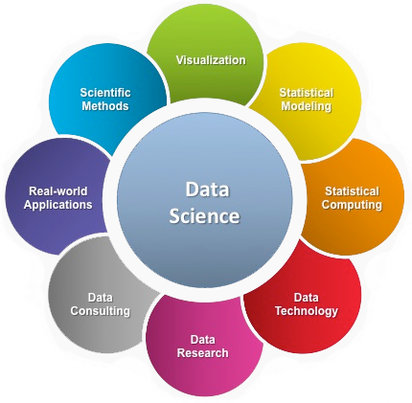
What is Data Science?
Theories and techniques from many fields and disciplines are used to investigate and analyze a large amount of data to help decision makers in many industries such as science, engineering, economics, politics, finance, and education
Computer Science
Pattern recognition, visualization, data warehousing, High performance computing, Databases, AI
Mathematics
Mathematical Modeling
Statistics
Statistical and Stochastic modeling, Probability.

Slide 9

Real Life Examples
Companies learn your secrets, shopping patterns, and preferences
Data Science and election (2008, 2012)
1 million people installed the Obama Facebook app that gave access to info on “friends”
Sports

Slide 10
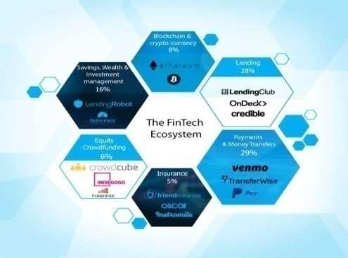
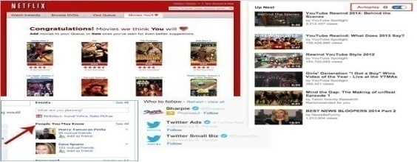
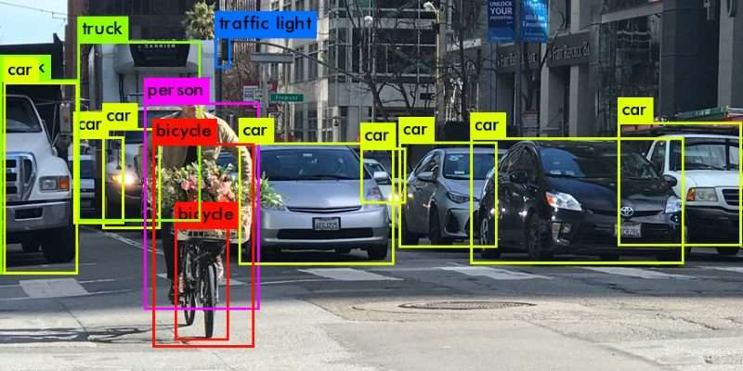

Banking and Finance
Recommender System
Image Processing
Speech recognition

Slide 11
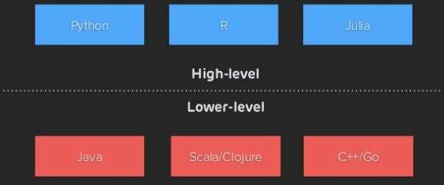
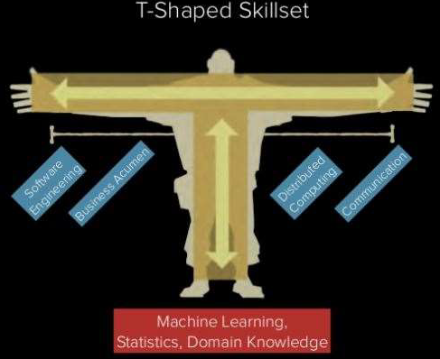
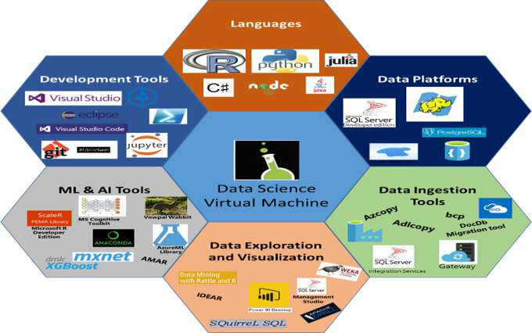
Skills need to become data scientist
Data Scientists need to know how to “CODE”
Statistical Analysis, Machine Learning
Other languages, tools, platforms and visualization

Slide 12
Skills need to become data scientist
Data Visualization, Data-Driven Problem Solving ,research mind set ,commutations

Slide 13
Job Roles In Data Science
Data Analyst
Data Engineers
Data Architecht
Machine Learning Engineer
Data Scientist
Statistician

Slide 14
Thank you for your attention. Any queries welcome

